Slide 1

Information sources and retrieval
Dr Alveen Singh
Department of Information Technology
Research skills/Project 3A
Advanced Diploma in ICT/B. ICT
Semester 1 2023

Slide 2
Content
Understanding the state of the art
Sources of information
Evaluation of sources
Accessing information
Research tools

Slide 3
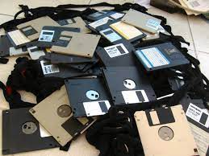

1. Understanding the state of the art
A researcher must have good understanding of the field or area of research to avoid falling onto the following problems:
  The intended study has been done before
  There are several recent developments that were overlooked, leading to flawed or outdated results
  Existing research has successfully solved the problem
  The sources of information are not recent and hence, no longer relevant
  Reinventing the wheel, instead of using recent publications as a springboard

Slide 4
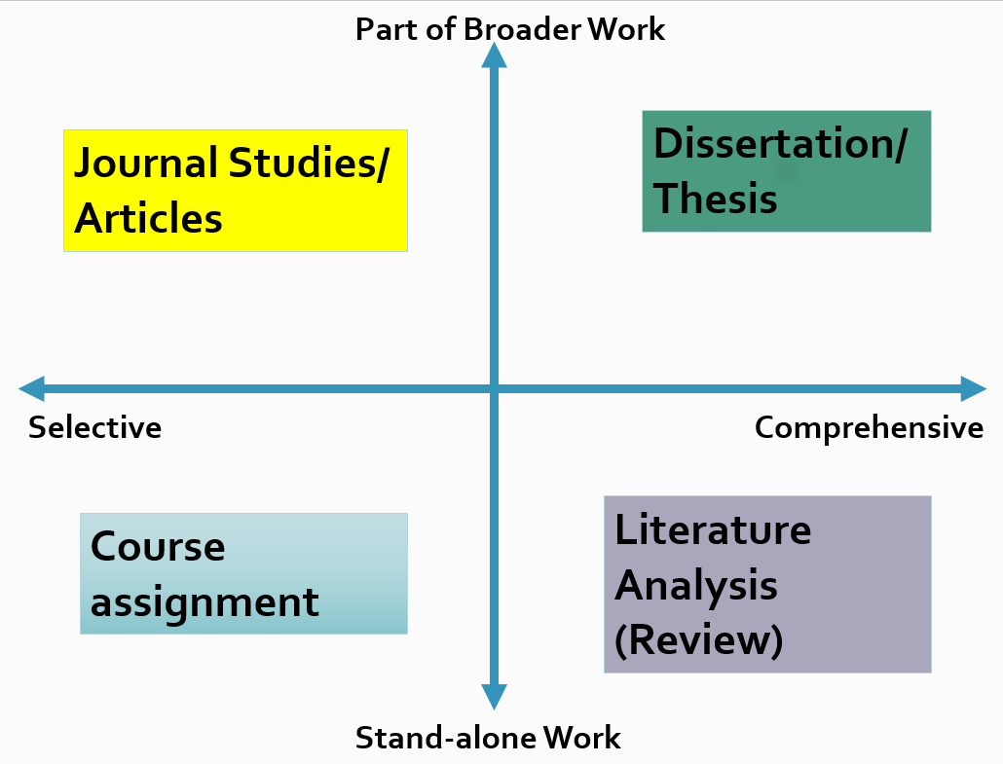
A quality literature study is key to avoiding the above shortfalls.
The preliminary literature review allows the researcher to get a broad understanding for the field of enquiry.
the full literature review must be done before empirical work begins.
  motivation for the need for the research via critical analysis of the state-of-the-art.
Wordvice

Slide 5
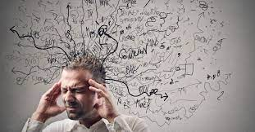
Information overload!
There are many publications contributing to a given field. The researcher has to identify the key authors, seminal works, accredited publishers and select only those sources relevant to their topic.
Use of search keys; inclusion and exclusion criteria
Medium.com

Slide 6
Consider the following research aim:
The IoT sensors used in a poly house are air temperature sensor, soil pH sensor, soil moisture sensor, humidity sensor and water volume sensor. This research aims to first, determine the challenges that these systems face and second, propose an architecture of IoT sensors that collect information and send it over the Wi-Fi network to the cloud for processing.
Write down 3 search keys to find relevant publications
Write down inclusion criteria
Write down exclusion criteria

Slide 7
IoT, Agriculture, Smart farming, Poly House and Sensors
Scopus database, English language, Journal, Book Chapter
Older than 5 years

Slide 8
2. Sources of information
There are various sources of information available to the researcher.
Some of these include:
Journal articles
Text books
Reference tools like online dictionaries and encyclopaedias
Technical reports
Conference proceedings
Conference posters
Dissertations/thesis
Professional body websites
Personal communication

Slide 9
3. Evaluation of sources
The researcher has many sources of information
The most reliable sources are journal articles, conference proceedings, and thesis and dissertations.
The above sources of information have some degree of peer review

Slide 10
The dissertation/thesis of Masters and PhD students have been examined by at least two experts in the field that have been appointed by the University.

Slide 11
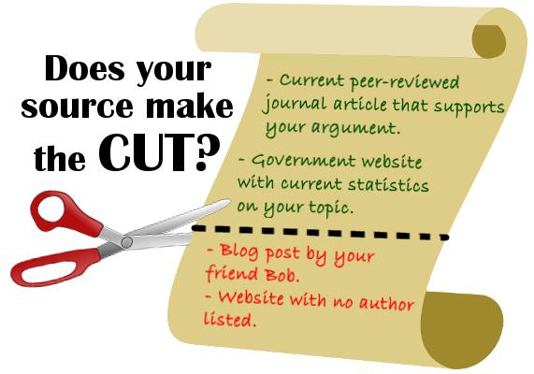
University of Denver

Slide 12
Which is the most reliable source?
  Website
  News paper article
  Conference poster
  Politician’s speech

Slide 13
Which source is peer reviewed?
  Edited book chapter
  Anything from Google
  Thesis
  Online news article

Slide 14
What is the difference between popular sources and scholarly sources of information?

Slide 15
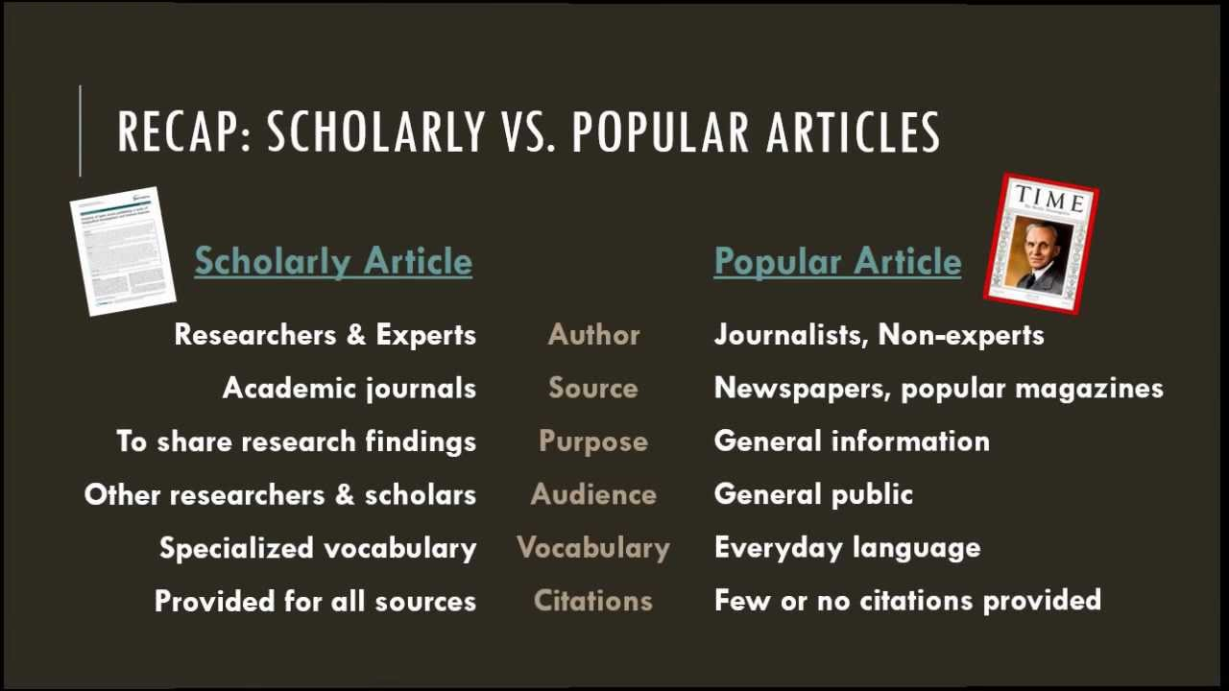
Gwinnett Tech Library

Slide 16
Differentiate between primary sources and secondary sources.

Slide 17
Primary sources
Proclaim new findings or knowledge.
When researchers produce new knowledge this is shared with the research community.
These advance the field of enquiry (discourse) via scholarly sources. That is, the publication is peer reviewed to validate the findings and/or results.
Primary sources can also include dissertations/thesis.

Slide 18
Secondary sources
Provide a simplification, summary or analysis of several primary sources
A literature review is a common secondary source of information. Researchers use it to synthesize literature to provide a view on the state of the field.
Or
Data that has already been collected and stored

Slide 19
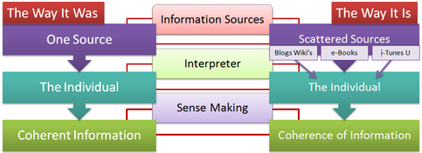
4. Accessing information
There is a myriad of sources of information
The researcher must have the ability to manage this process
ePubgeneration.com

Slide 20
The researcher needs to adopt a methodical approach to accessing information. One approach is to:
1. Find sources (preferably journals, and conference proceedings)
2. Determine the quality of the content
3. Utilise a tool to organize the sources according to different sub-sections of the study

Slide 21
The relevancy of the source can be gauged by:
1. title
2. abstract
3. number of citations
4. impact factor of the journal

Slide 22
5. Research tools – citation management
Citation management tools assist the researcher to create local libraries of sources of information that they can reference, sort, share and organize their research work.
Typically add-ons to a word processing package.
RefWorks, EndNote, Zotero, Mendeley, and F1000 Workspace

Slide 23
The major uses include
organizing references
citations can be directly imported from databases or search engines
search databases for articles on a particular topic
generate bibliographies/reference lists
change the reference system (IEEE, Harvard)
file management (e.g. pdf articles)
networking with peers to share articles, libraries of references

Slide 24
Please read the lecture note for this section.
Available on Moodle.
Questions and comments are welcome: alveens@dut.ac.za

